Slide 1

Presentation Materials Created by Mimetics Inc.
Free use by anyone for non-commercial purposes
Copyrights, Trademarks and other Registered Marks the Property of their Owners

Slide 2

Grade 6 Systems -
Mathematics & Variables
Notes:
We want to introduce the Jade Robot and it’s Tools in more detail along with our action plans for it.
It’s interesting, but it’s easy to criticize something when it’s done (especially when you have experience) – a *LOT* more difficult getting it right from the start. Also, preparing this presentation was a great way to review and think about what we should be doing.

Slide 3
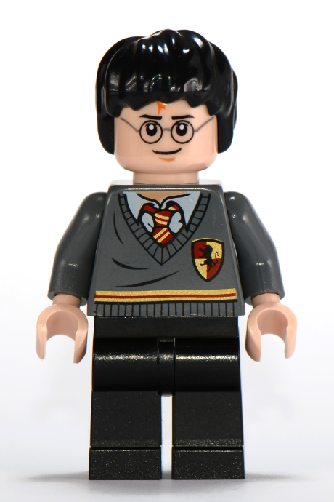
Recap
What is Programming?
What is a Loop?
What are Sensor Values?
What are the Mathematical Operations?
Notes:
Can Demo Jade Scratch if people are interested. In doing this product I’ve had a few interesting discoveries – one was going with a simpler programming language actually has a *LOT* of value for an expert like myself.

Slide 4
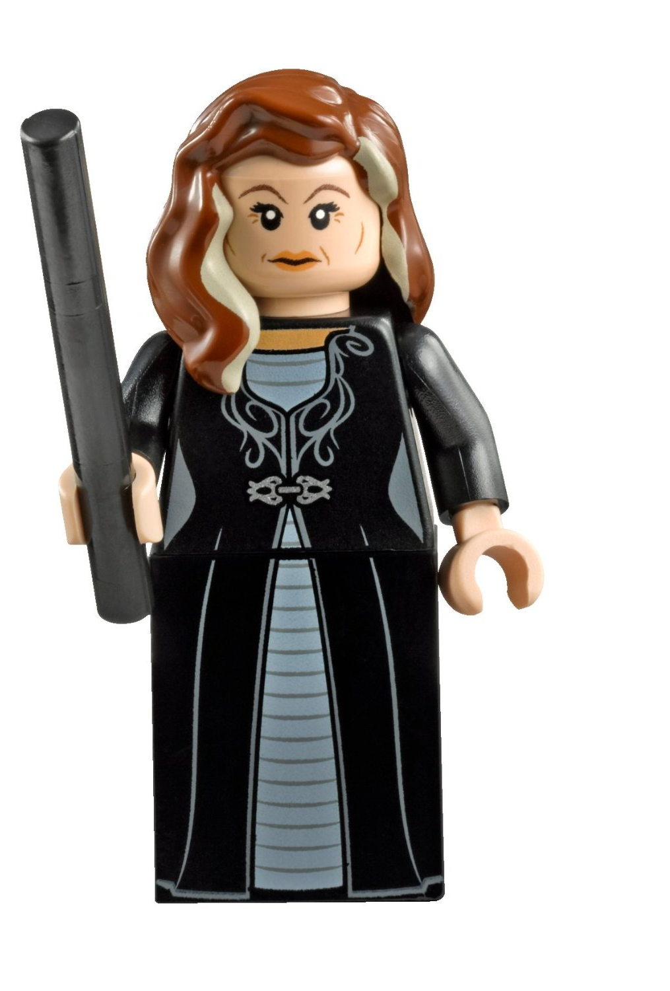
Creating a Program
Get Requirements
Break Requirements into Parts
For Each Part, List Statement Types Needed
Create a Sequence of Statements
Test Statements for Each Part
Work in Sequence and Build Up the Program as the Sum of the Parts
Test Final Program to Requirements
Celebrate!!!
Notes:
Can Demo Jade Scratch if people are interested. In doing this product I’ve had a few interesting discoveries – one was going with a simpler programming language actually has a *LOT* of value for an expert like myself.

Slide 5
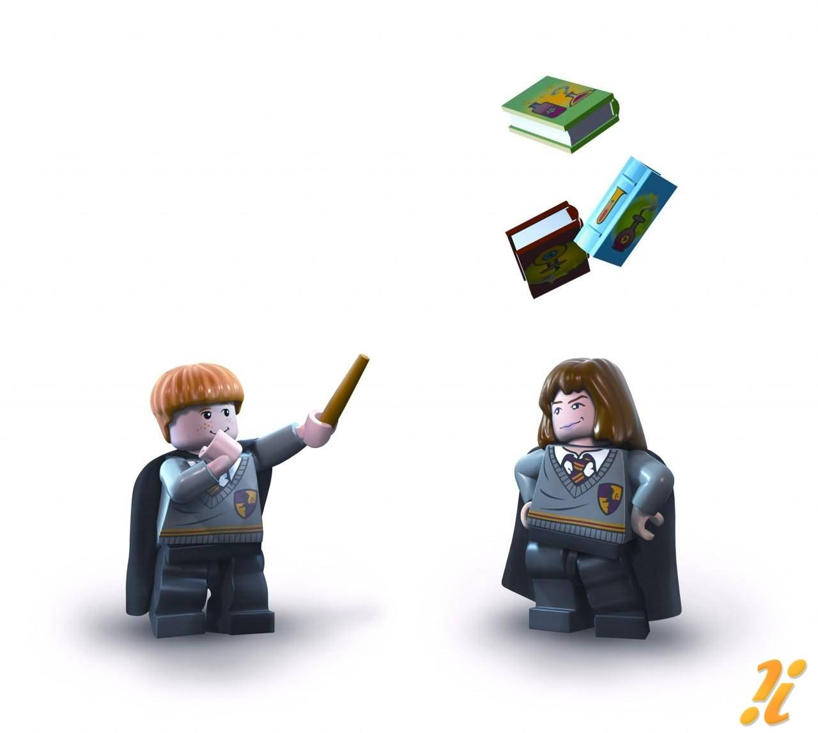
Robot Program Structure
Initialize Robot
Get Input
Process
Repeat (Loop)
Output Processed Inputs
Shutdown Robot
(Stop)
Notes:
Can Demo Jade Scratch if people are interested. In doing this product I’ve had a few interesting discoveries – one was going with a simpler programming language actually has a *LOT* of value for an expert like myself.

Slide 6
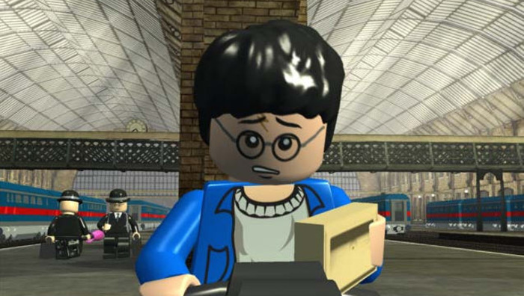
What to do when things go wrong
Notes:
Can Demo Jade Scratch if people are interested. In doing this product I’ve had a few interesting discoveries – one was going with a simpler programming language actually has a *LOT* of value for an expert like myself.

Slide 7
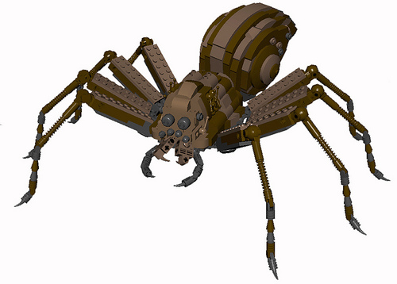
Steps to find a problem
Check Spelling/Statements
Single Step through the Program
Add Display Updates and LED Outputs to Track Progress
Isolate small Parts of the Program and Test Operation
Notes:
Can Demo Jade Scratch if people are interested. In doing this product I’ve had a few interesting discoveries – one was going with a simpler programming language actually has a *LOT* of value for an expert like myself.

Slide 8

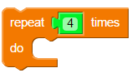
Repeat # Loop
Statements Inside Loop Statement Are Repeated
Four Times
Notes:
Can Demo Jade Scratch if people are interested. In doing this product I’ve had a few interesting discoveries – one was going with a simpler programming language actually has a *LOT* of value for an expert like myself.

Slide 9
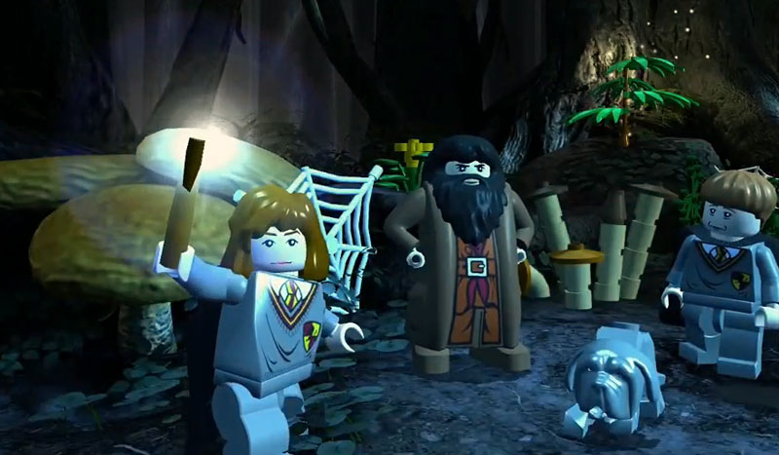
Variables
Notes:
We clone a community project into “My Projects” so we can make changes to it without affecting all the “Community Projects”

Slide 10

Algebraic Statements
A = A + 1
B = C * D
Notes:
Can Demo Jade Scratch if people are interested. In doing this product I’ve had a few interesting discoveries – one was going with a simpler programming language actually has a *LOT* of value for an expert like myself.

Slide 11
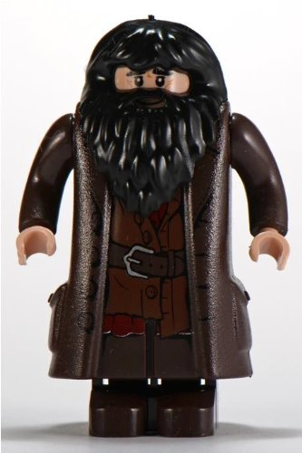
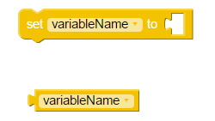
Things to Know About Scratch Variables
Initialize/Save Data in “variable”
Get Saved Data in “variable”
Variable Stores Integer Data
Variable Name Starts with “_”, “a”-”z”, “A”-”Z”
Notes:
Can Demo Jade Scratch if people are interested. In doing this product I’ve had a few interesting discoveries – one was going with a simpler programming language actually has a *LOT* of value for an expert like myself.

Slide 12
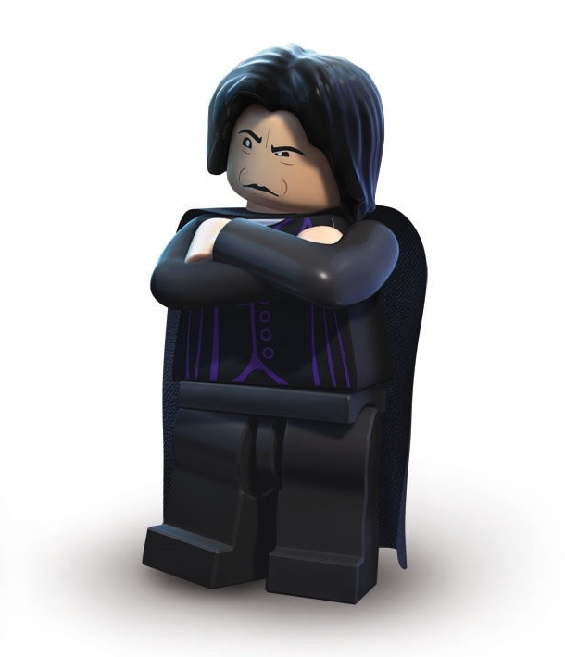
Initializing Variables
MUST Have a
Before:
Notes:
Can Demo Jade Scratch if people are interested. In doing this product I’ve had a few interesting discoveries – one was going with a simpler programming language actually has a *LOT* of value for an expert like myself.

Slide 13
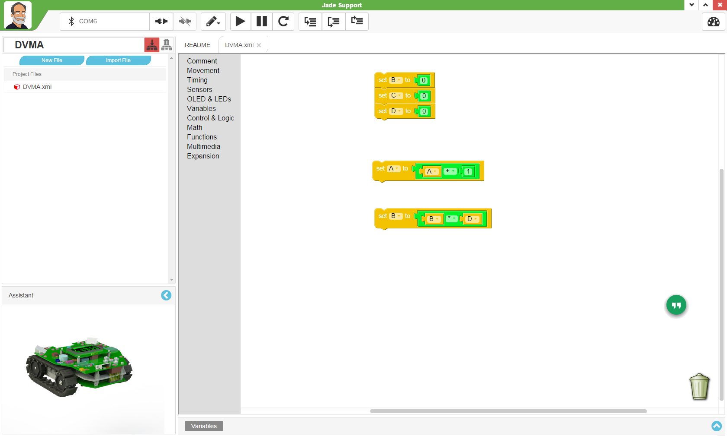
Algebraic Statements
A = A + 1
B = C * D
Notes:
Can Demo Jade Scratch if people are interested. In doing this product I’ve had a few interesting discoveries – one was going with a simpler programming language actually has a *LOT* of value for an expert like myself.

Slide 14
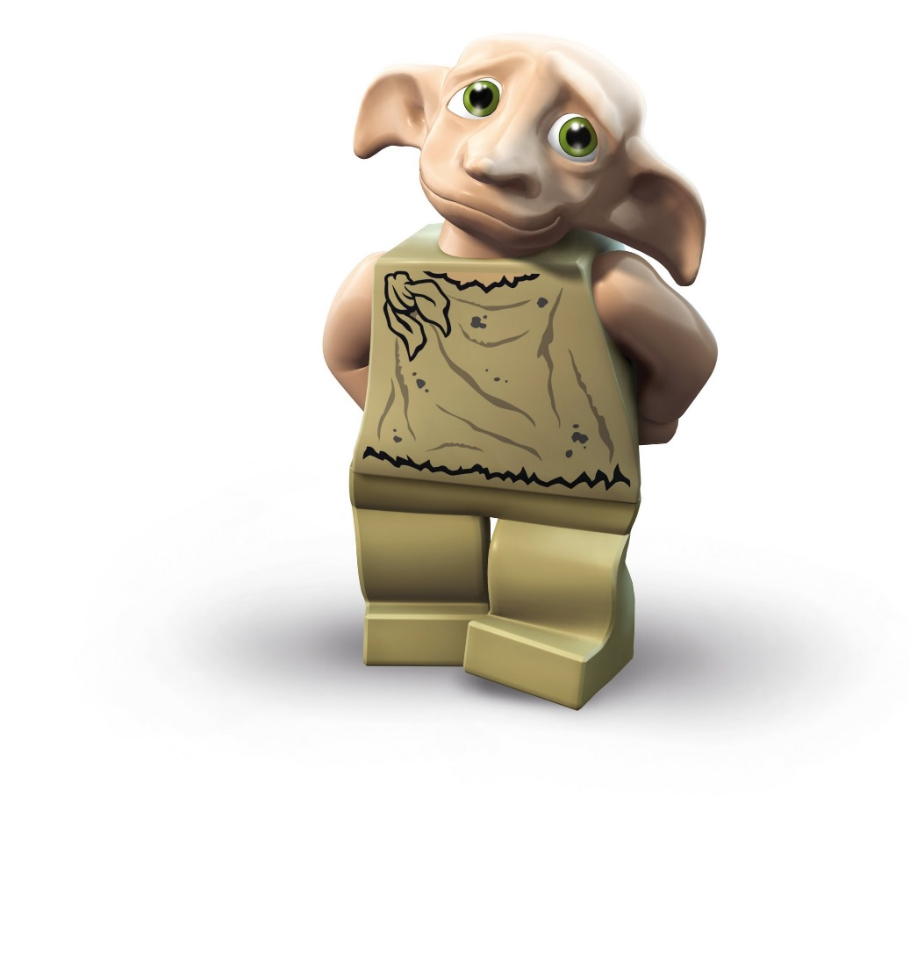
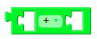
Arithmetic Operators
1st
2nd
“+” is Addition: 1st + 2nd
“-” is Subtraction: 1st – 2nd
“*” is Multiplication: 1st x 2nd
“/” Returns Quotient of 1st / 2nd
“%” Returns Remainder of 1st / 2nd
Notes:
Can Demo Jade Scratch if people are interested. In doing this product I’ve had a few interesting discoveries – one was going with a simpler programming language actually has a *LOT* of value for an expert like myself.

Slide 15
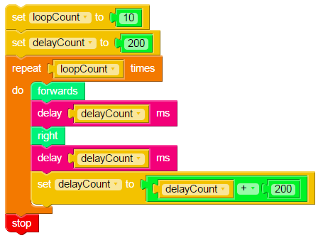
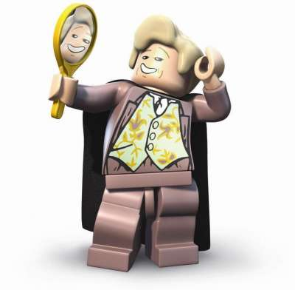
“Var1”
Notes:
Can Demo Jade Scratch if people are interested. In doing this product I’ve had a few interesting discoveries – one was going with a simpler programming language actually has a *LOT* of value for an expert like myself.

Slide 16
Robot Program Structure
Initialize
Get Input
Process
Repeat (Loop)
Output Processed Inputs
Shutdown Robot
(Stop)
Notes:
Can Demo Jade Scratch if people are interested. In doing this product I’ve had a few interesting discoveries – one was going with a simpler programming language actually has a *LOT* of value for an expert like myself.

Slide 17
Initialize
Loop
Process & Output
Shutdown
Notes:
Can Demo Jade Scratch if people are interested. In doing this product I’ve had a few interesting discoveries – one was going with a simpler programming language actually has a *LOT* of value for an expert like myself.

Slide 18
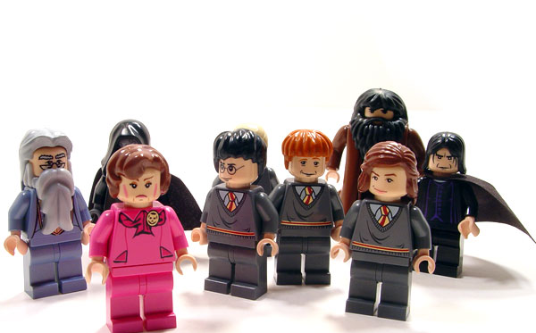
Movement Algebra (Algorithm)
Movement ⬅ (Forwards * delayCount) + (Right * delayCount)
Notes:
Can Demo Jade Scratch if people are interested. In doing this product I’ve had a few interesting discoveries – one was going with a simpler programming language actually has a *LOT* of value for an expert like myself.

Slide 19
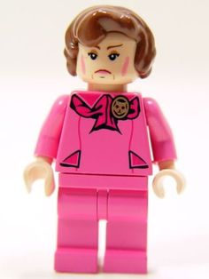
In Class Assignment
Develop a Movement Formula & Draw a Prediction of What it Should Look Like
Create a Program to test the Prediction
Compare the Prediction to Actual
Notes:
Can Demo Jade Scratch if people are interested. In doing this product I’ve had a few interesting discoveries – one was going with a simpler programming language actually has a *LOT* of value for an expert like myself.

